Slide 1
3D racing web game
By Tamer Hussen

Slide 2
Task
To create and present a 3D web game and website using HTML, CSS and JS.

Slide 3
Game Type and description
Type: racing simulator game
Description: Players will race and avoid obstacles to gain a high score.

Slide 4
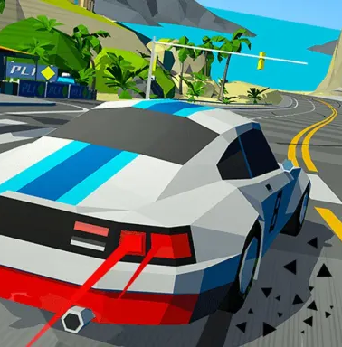
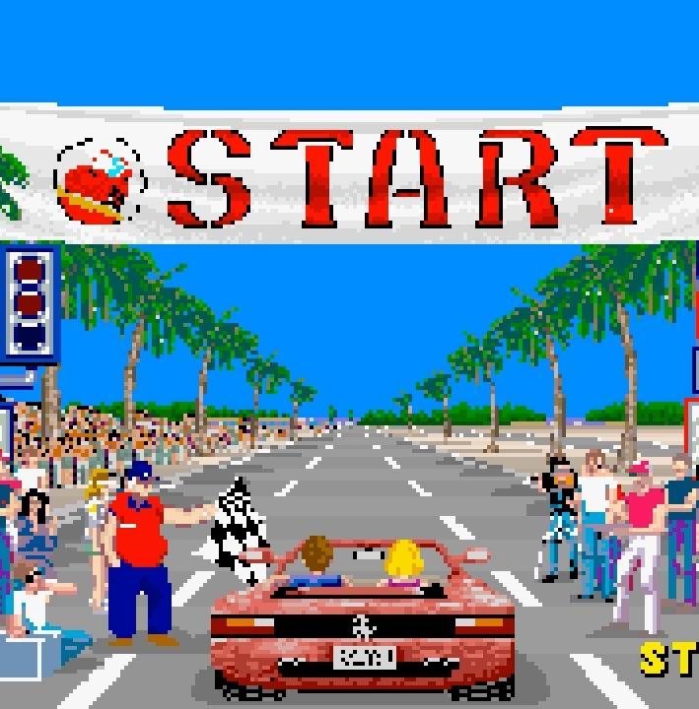
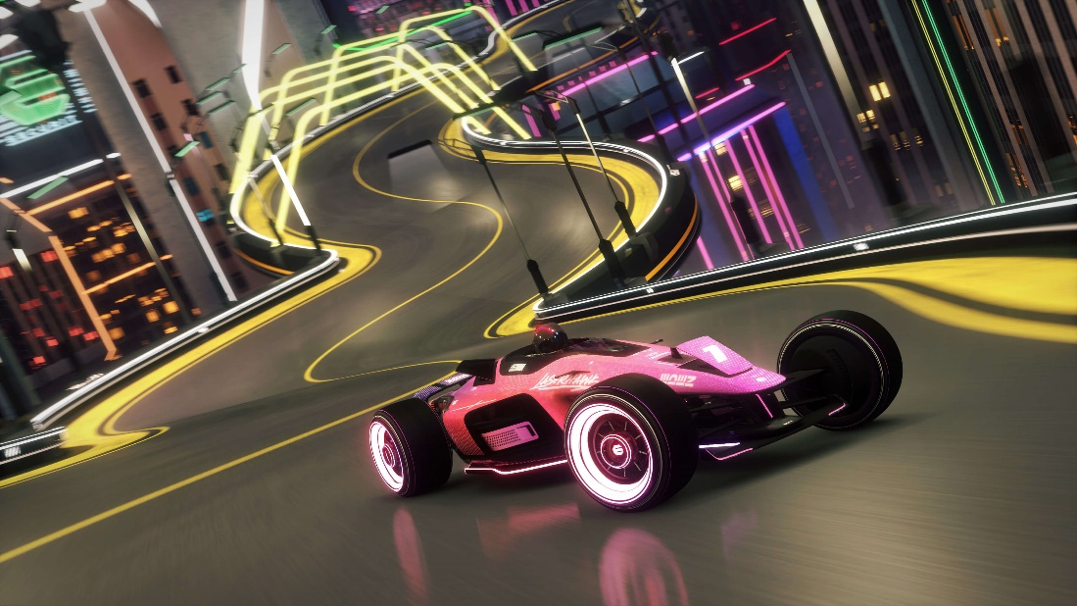
Image examples
Image 2 - gameplay
Image 3 - FOV
Image 1 - style

Slide 5

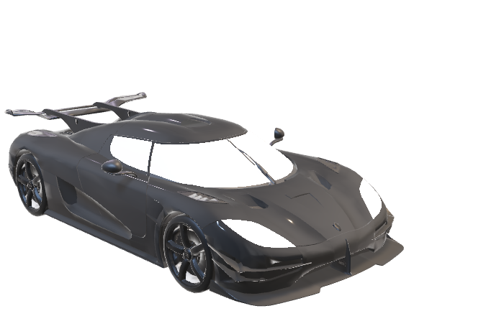
assets
Player character - car
Sky box - Forest

Slide 6
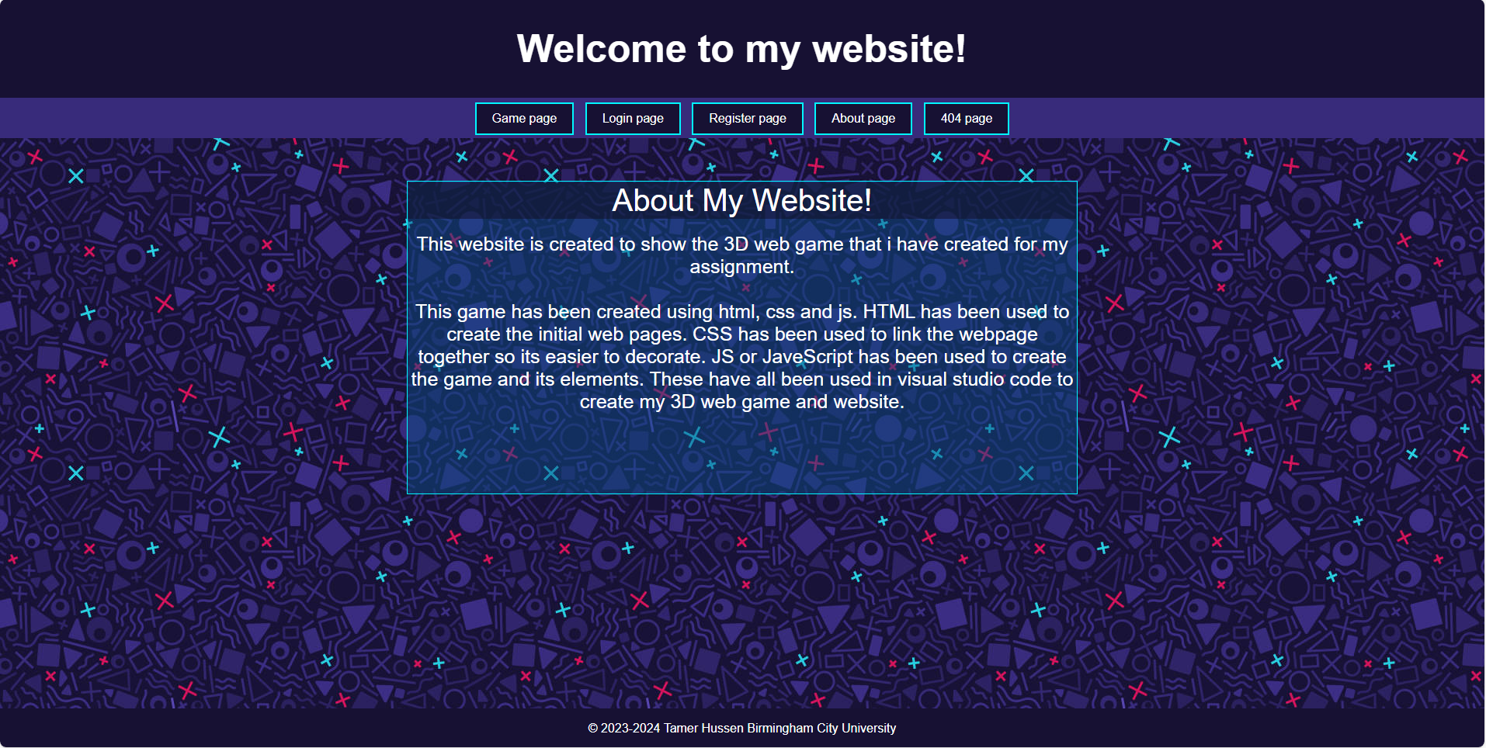
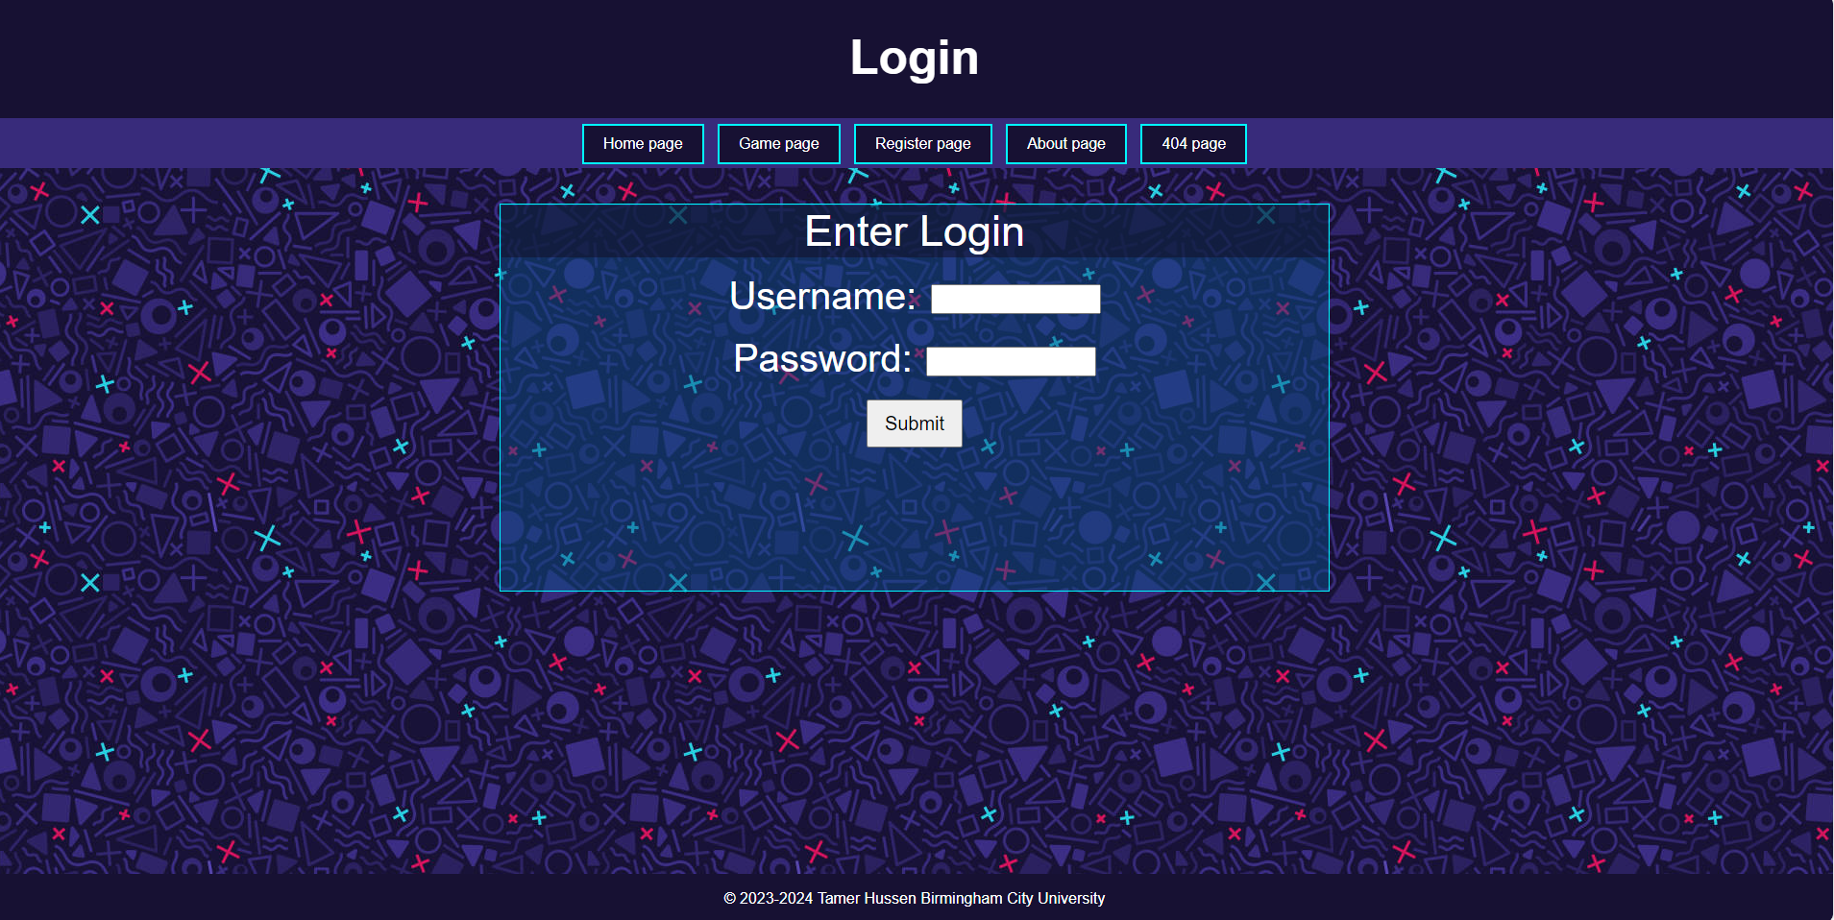
Website preview
Image 1 – home page of website
Image 2 – login page of website

Slide 7
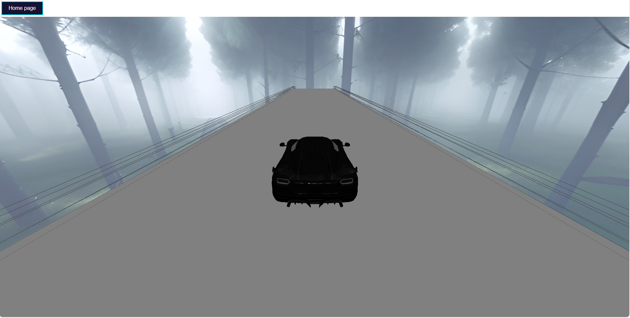
Game preview
Image 1 – game with home button to take back to home page

Slide 8
references
3D Models for Free - Free3D.com
- 3D models
Sketchfab
- Skybox
Three.js – JavaScript 3D Library
- JavaScript codes
https://youtu.be/faHxj0RYLZE
- Code assist
W3Schools Online Web Tutorials
- Website examples

Slide 9
Any questions?

